Slide 1
Executive Office of
Elder Affairs
RESPECT INDEPENDENCE INCLUSION

Slide 2
Key Provisions of HUD Notice
Section 4.4(F) Design Considerations for Elderly Housing
Encourages owners to incorporate design standards that address fall prevention, visitability, universal design and electronic communication mechanisms
Section 4.4(S) Supportive Services for the Elderly
Requires owners to demonstrate that needs of residents are adequately met through a RSC or other service provision arrangement
Section 4.4(T) Provision of Services
Allows owners to request up to $27/unit/month from project rental assistance to provide effective supportive services for the elderly

Slide 3
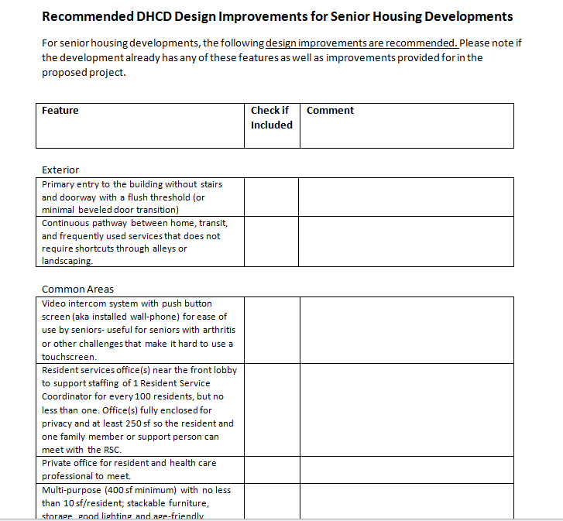
Upcoming DHCD Design Standards
To be included in Draft QAP
Adapted from Design Standards from Enterprise Aging in Place Toolkit

Slide 4
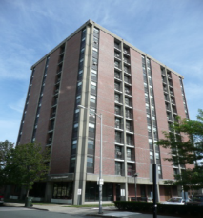
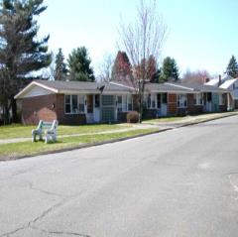
Resident Service Coordinators (RSCs)
The availability of an on-site service coordinator at federally subsidized senior housing reduced the odds of having a hospital admission among residents by 18% (Leading Age)
EOEA Funds RSCs in Senior Housing
Older people in housing with services were 51% less likely to be hospitalized and if hospitalized, spent less time in the hospital than a comparison group
(Selfhelp Active Services for Aging Model)
Notes:
Very few funding sources for RSCs, but valuable position
EOEA has line item to fund RSCs in public housing – but still a huge gap.
Prevents hospitalization
Increases housing stability

Slide 5
Service Options for Aging in Community
PACE
SCO
Home Care
55+
MassHealth Standard*
Clinical Criteria
65+
MassHealth Standard
60+
Clinical Criteria
Nursing Facility Level of Care
Interdisciplinary Team model
Robust needs-based services
24/7 access to staff
Geographically based
Not statewide
8 programs with 23 centers
Basically statewide
Access to Care Manager 24/7
No co-payments or out of pocket costs
Enhanced dental benefits
6 plans
1 ADL or 6 IADLs and a critical unmet need
Overseen by Aging Service Access Point (ASAP)agencies
Statewide – 26 ASAPs
Different types depending on need and income
*or private pay if income exceeds $2,313/month
PACE – Program for the All Inclusive Care of the Elderly
SCO – Senior Care Options

Slide 6
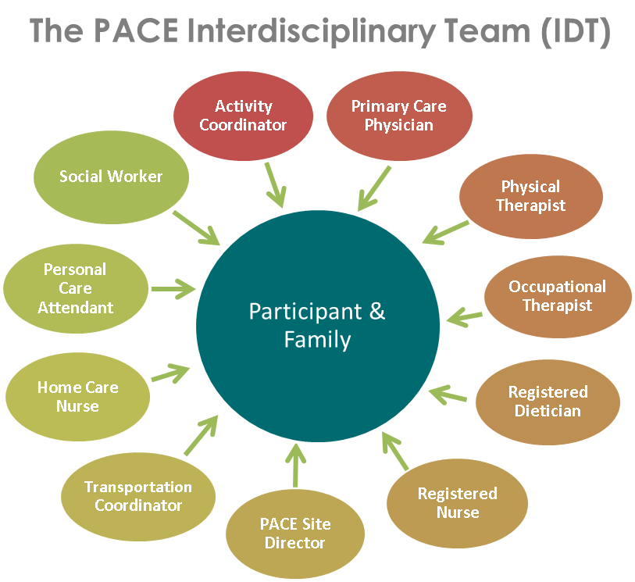

Slide 7
PACE Benefits & Services (Covered in Full)
Primary Care | Medical supplies and equipment
Preventive Care | Nursing home care and Inpatient hospitalization care as needed
Home Care | Specialty care services, such as cardiology, ophthalmology and podiatry
Adult day health care services | Social wok support and services
Medications | Dental and vision care, including eyeglasses
Transportation | Caregiver education and support
Physical, occupation and speech therapy | Dietary and Nutrition Guidance
Medication management | Other services as prescribed by the interdisciplinary team

Slide 8
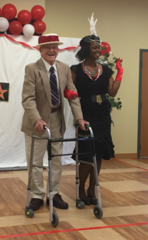
What’s at a PACE Day Center?
• Recreation & socialization
• Primary care
• Rehab services
• Social services
• Dietary services
• Meals

Slide 9
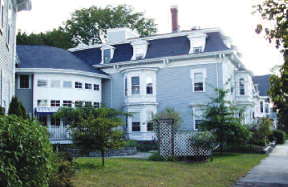
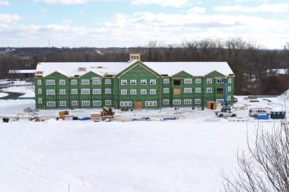
Examples of PACE and Housing
Hillside Residence, West Springfield
Sisters of Providence & Mercy Life PACE
34 units
Harborlight House, Beverly
Harborlight & Element Care PACE
30 units
PACE Set-Asides in Public Housing in:
Boston
Cambridge
Fitchburg
Leominster
Ludlow

Slide 10
PACE Programs
Elder Service Plan of Cambridge Health Alliance
Elder Service Plan of Harbor Health
Element Care
Mercy LIFE
Neighborhood PACE
Serenity Care
Summit ElderCare
Upham’s Elder Service Plan

Slide 11
The Home Care Program
Home Care Basic/Non-Waiver
Community Choices*
Home Care Over Income
Enhanced Community Options
Home Care Basic/Waiver*
Respite Over Income
* Frail Elder Waiver Program, MassHealth Standard (Expanded Income Eligibility – 300% SSI FBR)

Slide 12
Home Care Services
Adult Day Health
Alzheimer’s/
Dementia Coaching
Behavioral Health Services
Chore
Companion
Environmental Accessibility Adaptations
Grocery Shopping/Delivery Services
Home Based Wandering Response Systems
Home Delivered Meals
Home Delivery of Pre-packaged Medication
Homemaker
Home Health Aide

Slide 13
Home Care Services
Laundry Services
Medication Dispensing System
Nutrition Assessment/
Counseling
Occupational Therapy
Personal Care
PERS/Enhanced PERS
Respite
Skilled Nursing
Supportive Day Program
Supportive Home Care Aide
Transportation
Transitional Assistance
Vision Rehabilitation

Slide 14
ASAPs
Baypath
Boston Senior Home Care
Bristol Elder Services
Central Boston Elder Services
Coastline
Elder Services of Berkshire County
Elder Services of Cape Cod and the Islands
Elder Services of Merrimack Valley
Elder Services of Worcester Area
Ethos
Greater Lynn Senior Services
Greater Springfield Senior Services
HESSCO
Highland Valley Elder Services
LifePath
Minuteman Senior Services
Montachusett Home Care
Mystic Valley Elder Services
North Shore Elder Services
Old Colony Elder Services
SeniorCare
Somerville/Cambridge Elder Services
South Shore Elder Services
Springwell
TriValley
WestMass Elder Care

Slide 15
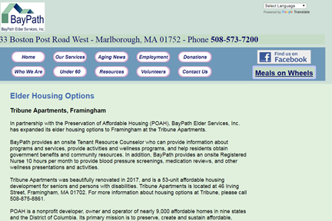
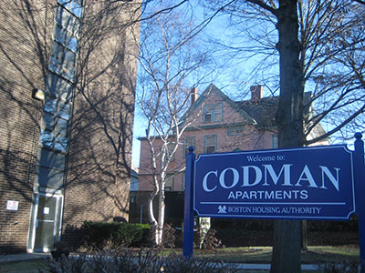
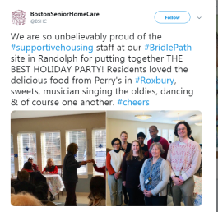
Examples of ASAPs and Housing
ASAPs Partnering with Housing
EOEA Supportive Housing
RSC in 41 public housing sites
6,000+ residents

Slide 16
Emily Cooper
Chief Housing Officer
MA Executive Office of Elder Affairs
Special Adviser on Housing
MassHealth
emily.cooper@state.ma.us
(617) 222-7472

